Slide 1
The BATtle of the Neighborhoods
Applied data science capstone ibm/Coursera
Taejin Jung

Slide 2
Recomending location for Korean cuisine in toronto
In Toronto, there are a large number of restaurants.
However, the number of Korean restaurant is relatively smaller than other restaurants.
Visualizing present Korean restaurants, all restaurants, and candidate location is in the process of this analysis.

Slide 3
Data acquisition and cleaning
Table of postal code, borough, and neighborhood of Toronto from Wikipedia, scraped from https://en.wikipedia.org/wiki/List_of_postal_codes_of_Canada:_M
Csv file that has the geographical coordinates of each postal code from http://cocl.us/Geospatial_data
Using Foursquare API, this project will get the nearby venues of each borough.
Duplicate, similar or correlated features will be dropped.

Slide 4

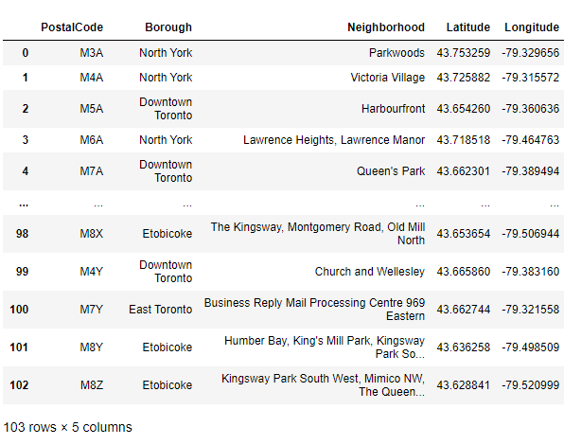
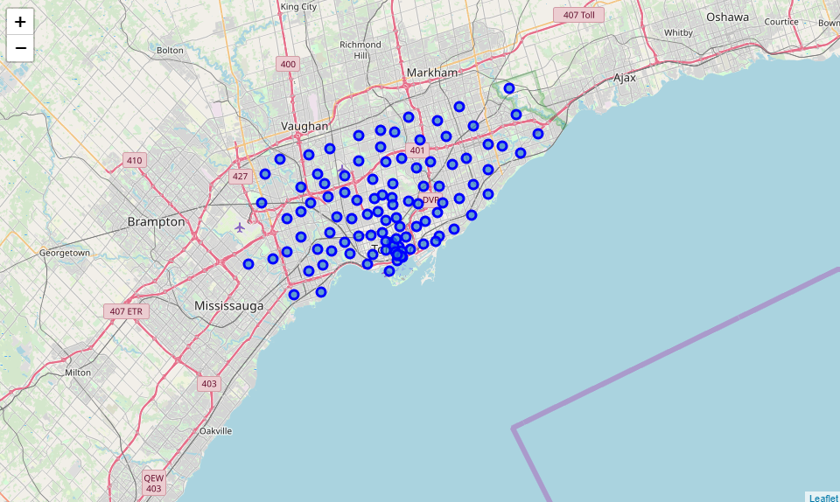
Dataframe of coordinates and visualization of each borough of Toronto

Slide 5
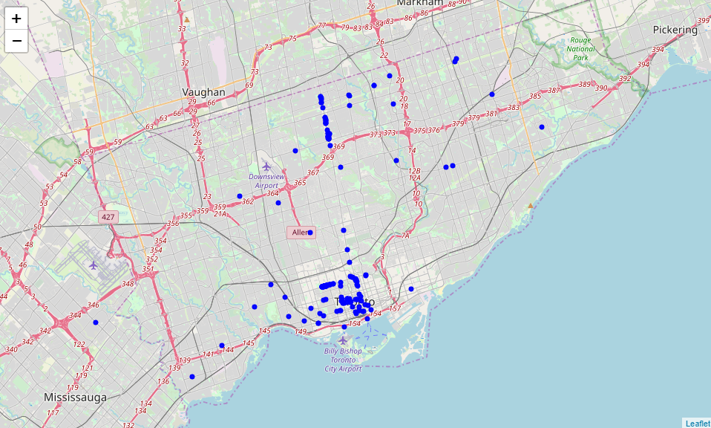
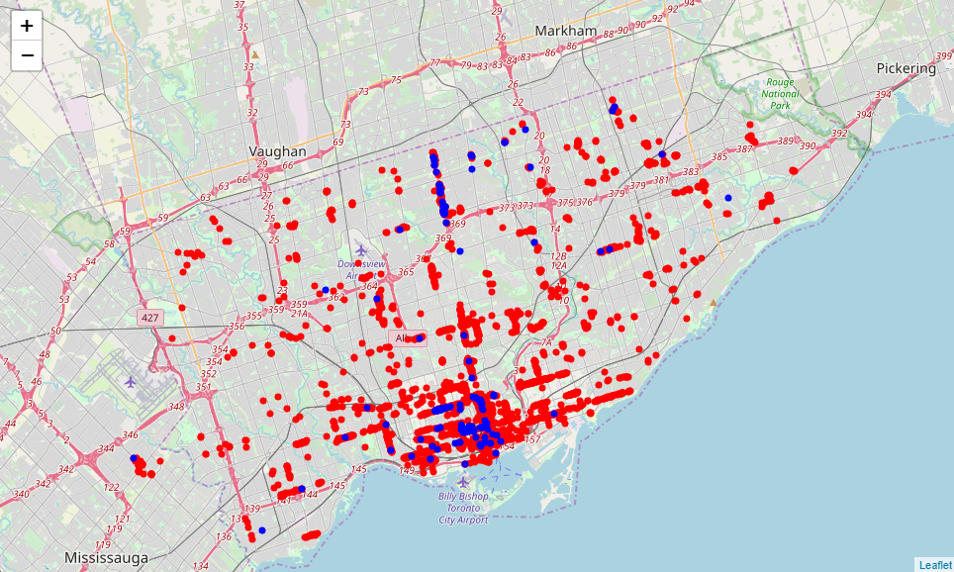
Location of Korean restaurants And All restaurants in Toronto
Blue mark: Korean
Red mark: All restaurants

Slide 6

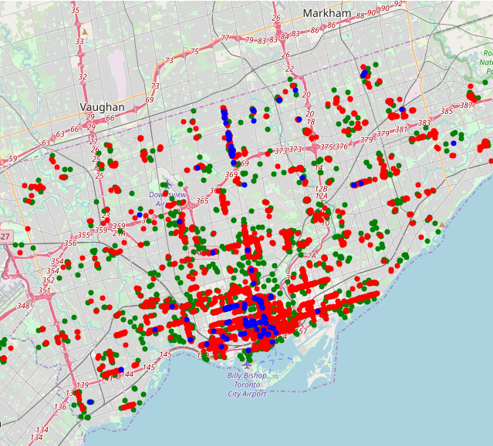
Visualization of Korean, all restaurants and candidate locations
BLUE: KOREAN
RED: ALL RESTAURANTS
GREEN: CANDIDATE LOCATION

Slide 7
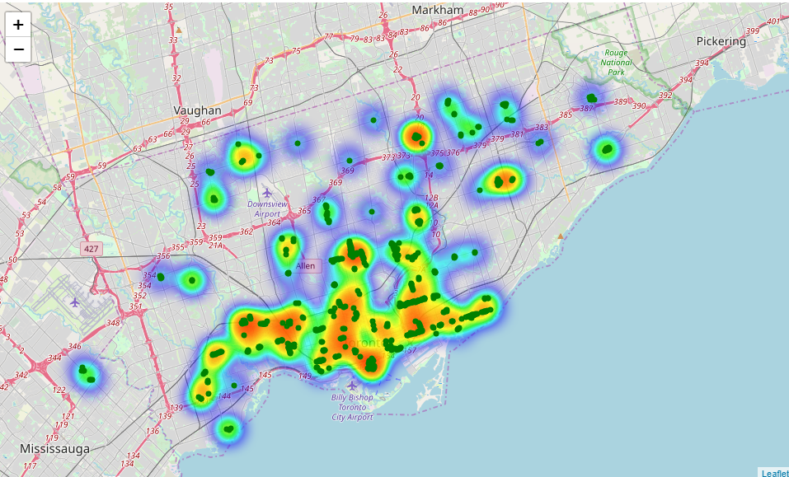
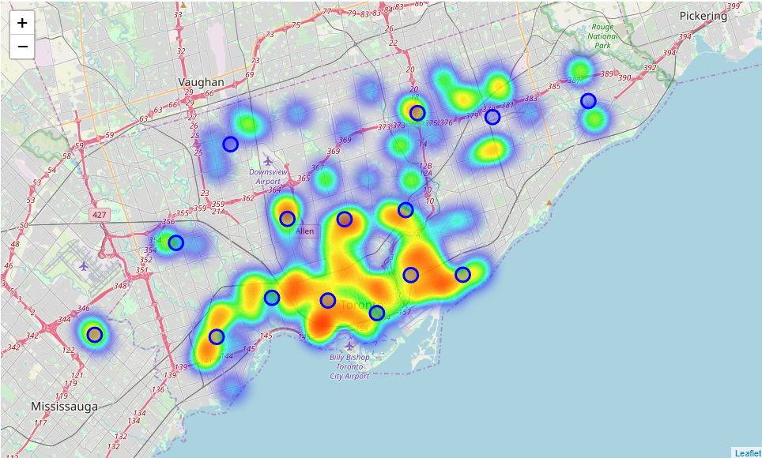
Heatmap of possible locations and centers of each clusters
Heatmap of Possible locations heatmap of each clusters

Slide 8
Conclusion and future directions
Consider more specific conditions
Level of noise
Real estate prices
Economic dynamics of neighborhoods

